Slide 1

COMMUNITY CONNECT – HOUSEHOLD HELPER PLATFORM
“Connecting households with trusted service providers”
Aditya Honnakasturi 2SD23IS006
Pratham Manjunath Hegde 2SD23IS034
Kiran Jantgal 2SD24IS402
Pradyumna Naik 2SD23IS032

Slide 2

The Problem
Hard to find verified plumbers, electricians, carpenters, cleaners, mechanics
Users face delays, poor quality, and overcharging
Providers miss customers & struggle with manual scheduling
No single trusted platform for booking services

Slide 3





Proposed Solution
Search & book nearby providers instantly
View ratings, reviews & availability
Digital history of bookings & payments
Real-time notifications for updates

Slide 4

Existing vs Proposed Technology
Existing Technology:
Proposed Technology:
Search through word-of-mouth, ads, or local shops
Manual scheduling with Excel sheets & registers
No ratings, reviews, or proper service tracking
Real-time search & instant booking of verified providers
Digital tracking of bookings, payments & service history
Transparent ratings & reviews for better trust

Slide 5
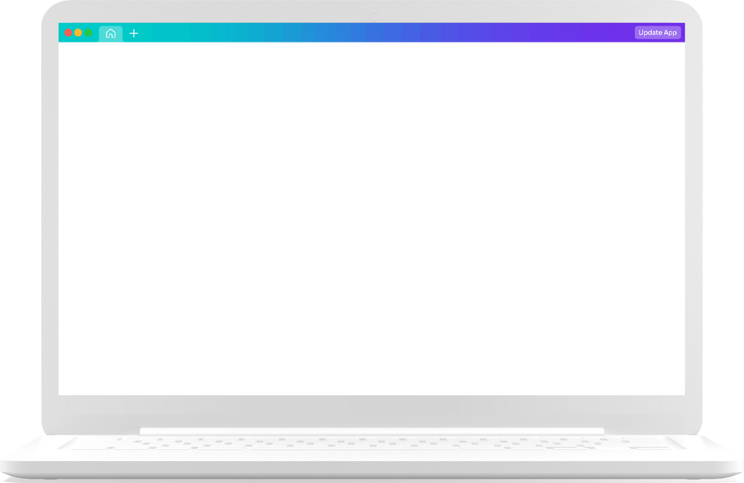

Tech Stack
Backend: Node.js + Express.js with MongoDB Atlas for data storage.
Frontend: React.js with TailwindCSS for better UI.
Mobile App: Flutter for cross-platform access by the users.

Slide 6

Impact of the System
Impact of the System
Increased business for service providers prevent missing entries.
Promotes digital adoption for everyday household services
Quick, reliable access to trusted helpers
Builds transparency & stronger community trust
Increased business for service providers prevent missing entries.
Promotes digital adoption for everyday household services
Quick, reliable access to trusted helpers
Builds transparency & stronger community trust

Slide 7
Thank you

